Slide 1

Boosting Algorithm

Slide 2
Boosting Algorithm
Boosting algorithms are the special algorithms that are used to augment the existing result of the data model and help to fix the errors. They use the concept of the weak learner and strong learner conversation through the weighted average values and higher votes values for prediction. These algorithms uses decision stamp, margin maximizing classification for processing.

Slide 3
Types of Boosting Algorithm
Gradient Boosting
XGBoost
AdaBoost
CatBoost
LightGBM

Slide 4
Ada-Boost
Ada-Boost short for Adaptative Boosting is an ensemble learning used in the machine learning
Transforming the weak learners into strong learner
By giving incremental weight concepts
Used for both classification and regression concepts

Slide 5
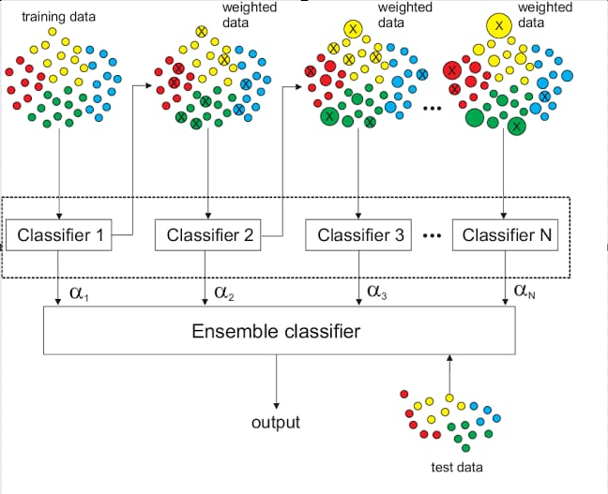
Ada-Boost

Slide 6
XG-Boost
XG-Boost stands for Extreme Gradient Boosting
Same as Gradient boosting but has additional functionality
Distributed machine learning process
More computational speed and model efficiency
Gradient Boosting sequentially slow

Slide 7
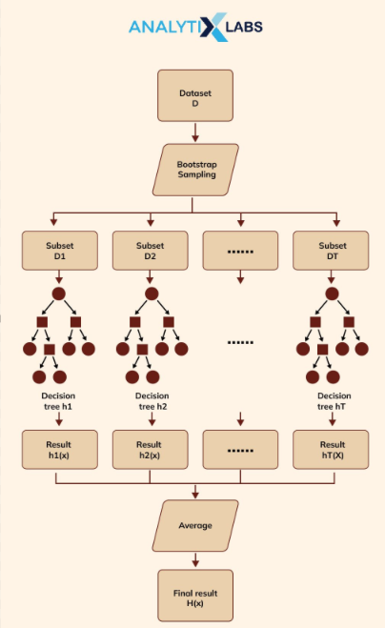
XG-Boost

Slide 8
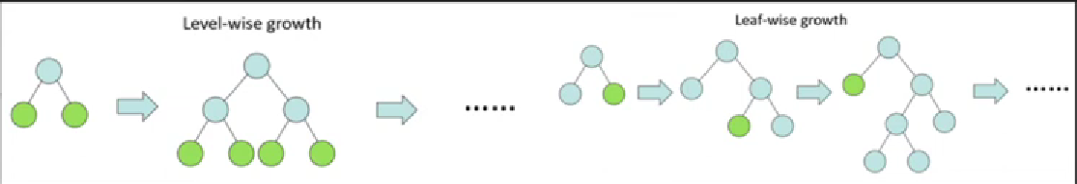
LG-Boost
Large amount of data easily handle
Poor in small dataset
It uses histogram based method for selecting the best fit
For continuous values splits up into bins or buckets
LG-Boost stands for Light Gradient Boosting Machine

